Slide 1
Results of the Programing week
Mines Paris PSL – DIAM

Slide 2
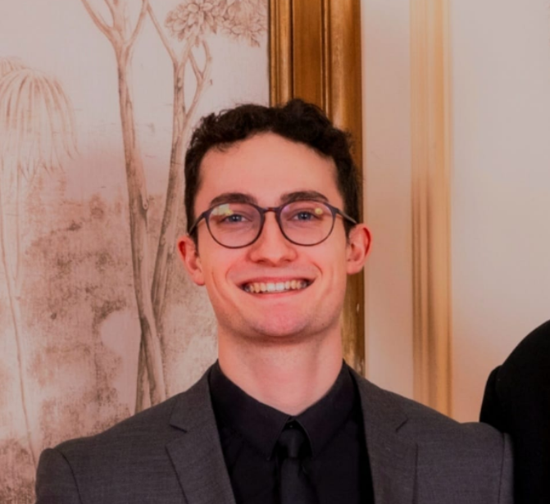
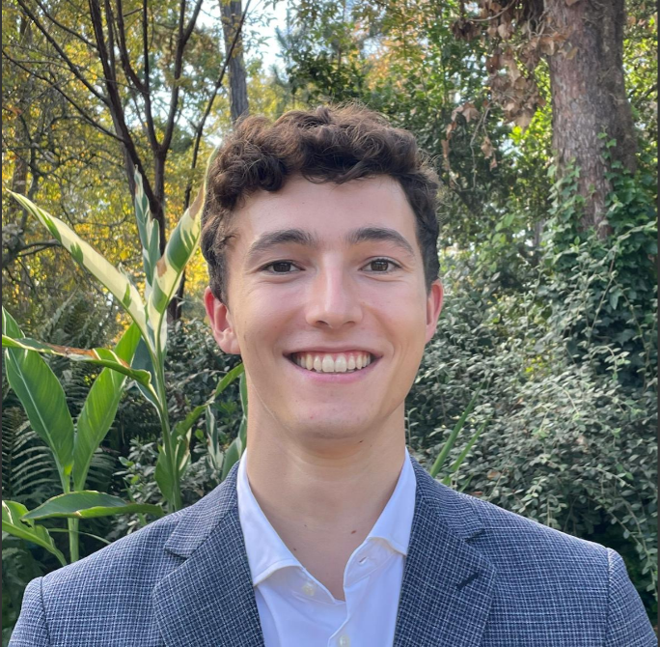
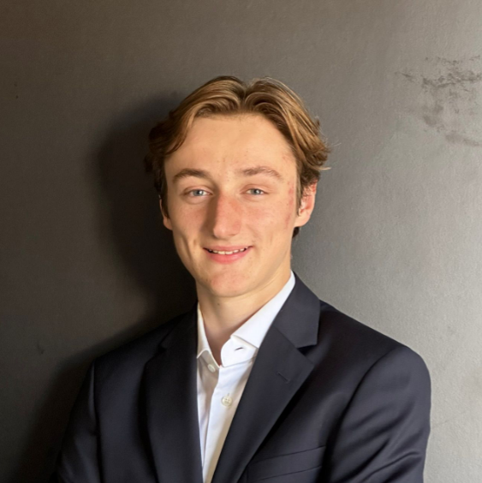
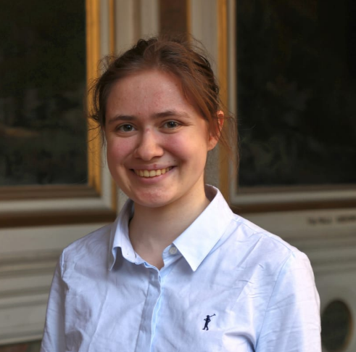
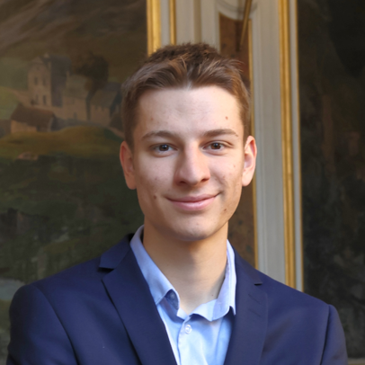
The Team
VICTOR FAYON
VINCENT BOURGADE
ALPHONSE RAYNAUD
CHRISTELLE DE BOUTRAY
ANTOINE BOSSIN

Slide 3
What was the objective ?
Build a model to optimize the distribution of orders on the machines.
Integrate a simple visualization of this distribution

Slide 4
Chronology
Week From 30/06
To 04/07
MONDAY
TUESDAY
WEDNESDAY
THURSDAY
FRIDAY
Mathematical modelisation
Preparing documentation
Comment the code
First simple version of code
Adding constraints
Debugging the code
Optimisation of the code
Understanding the problem

Slide 5
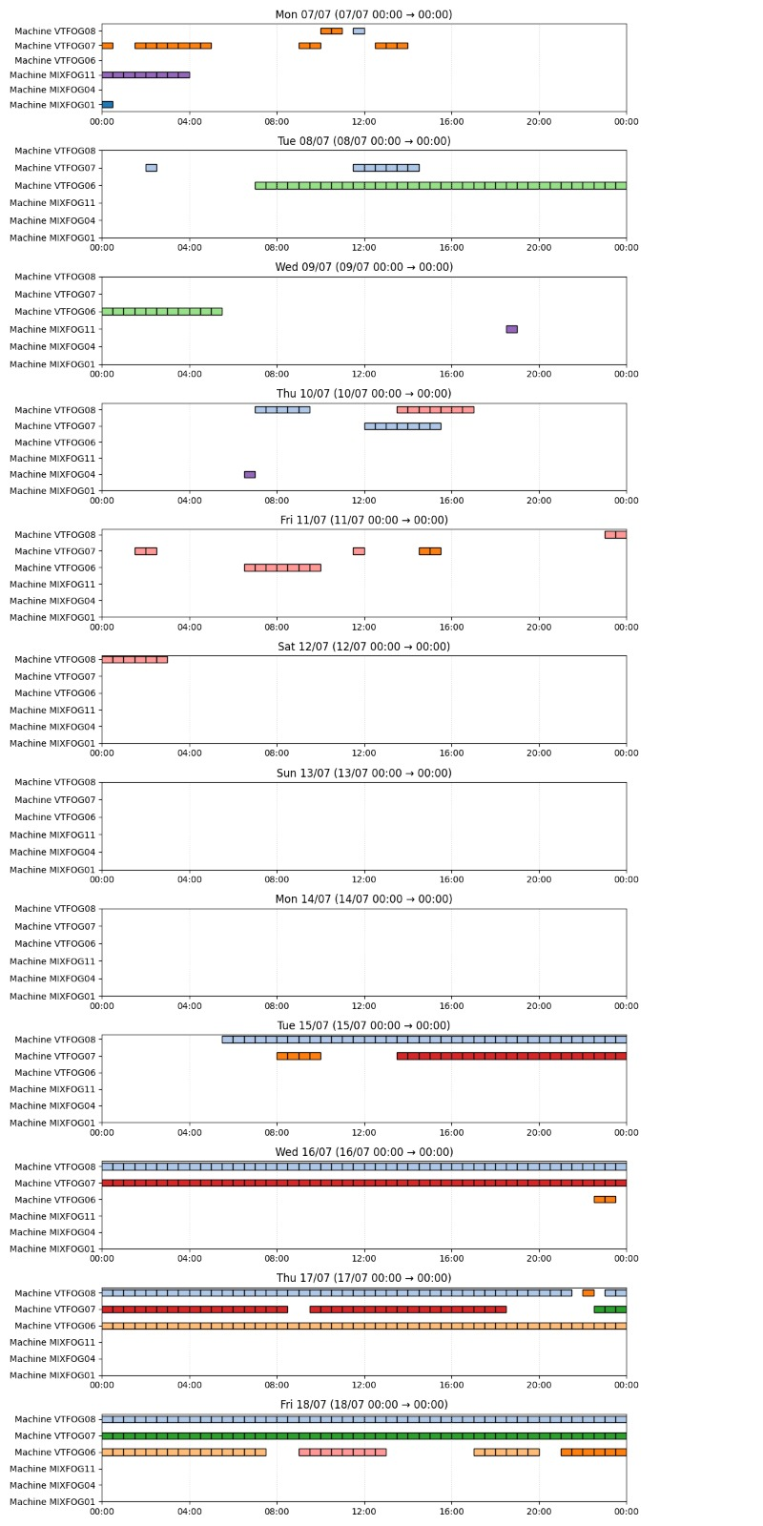
Our final output

Slide 6

The week in numbers
150
300
$$2^{100 000}$$
Hours of coding
Combinations explored
Lines of code

Slide 7

The perfect match to continue the project
VICTOR FAYON
victor.fayon@etu.minesparis.psl.eu
+33 7 68 52 96 85
antoine.bossin@jump-mines.fr
or
antoine.bossin@etu.minesparis.psl.eu

Slide 8
Thank you !
We hope it will help you…
…and that we can continue with us

